Slide 1




  Reducing Latency Through Page-aware Management of Web Objects by Content Delivery Networks
Shankar Narayanan§, Yun Seong Nam§,
Ashiwan Sivakumar§, Balakrishnan Chandrasekaran†,
Sanjay Rao§, Bruce Maggs†‡
§
ACM SIGMETRICS/IFIP Performance 2016
†
‡

Slide 2









Latency is critical for web applications
Direct financial implications
100 ms latency → 1% in sales
[Greg Linden, Make Data Useful]
Web applications need to be fast for good user experience !
500 ms page generation time → traffic by 20%
Adding search results → page 2% slower → 2% searches/user
[Marissa Mayer, Web 2.0 conference]
100ms response time: for web page to feel ”instantaneous” [Jakob Neilsen, Usability Engineering]

Slide 3





Modern Web Pages
Client
Content Provider
Web server
www.nytimes.com
Complex: consists of tens to hundreds of objects
Index.html
Complex page load process
Client parses initial HTML,
requests further objects
Web server responds with an initial HTML
Client requests page
CDN server
Objects served from multiple domains
Some pages: full-site delivery through CDNs
Third party servers

Slide 4

Objects in a page have different importance for page latency
Object dependency graph of apple.com
H1
Execution
Inter-object dependencies
Download
H1
P1
C 1-4
Some objects more important
e.g., CSS vs JS
J1
J 2,3
J4
Key:
H HTML
C CSS
J Javascript
S SVG
JPG JPEG
W Woff
C 1-4
Objects of same type -- not equally important
e.g., J [1,2,3] vs J4
J1
S 1-8
W1
J 2,3
W2
JPG 1-6
J 4

Slide 5

Content prioritization to improve web latency
SPDY protocol – a key part of HTTP 2.0
Goal: reduce page load latency
Key techniques: Multiplexing and prioritized object delivery (based on object Type)
  Avoids head-of-line blocking
  Delivers important objects quicker
Single SPDY conn
Client
server
SPDY: delivery between client and server
Does not specify how content is organized in servers and CDNs !

Slide 6





How is web content organized & served today?
Are the most important objects served from the fastest CDN tier?
Origin server
HTML1
CSS
HTML1
img1
JS1
Memory
CDN cluster
img2
HTML2
JS2
Disk
img1
JS1
Client browser
img2
2nd server
(peer)
JS2
CDNs often have limited information on page structure
1st server
(edge)
Parent CDN cluster
CDN is tiered
More popular objects at edge
prioritized delivery + priority-based caching at CDNs
SPDY
Our Framework

Slide 7



Our contributions
  Highlight opportunity to lower web-page latency
Key idea: map latency-critical objects to faster CDN tiers
Investigate a spectrum of prioritization schemes
Tradeoff: complexity of scheme vs benefits
Identify regimes when more page-awareness is helpful
Extensive evaluation study: 100 real-world pages (Alexa Top pages)
  >100 ms reduction in median latency for 35% of pages
Decrease miss rate of critical objects by 61%, with < 0.5% ↑ in overall miss rate

Slide 8











Understand how pages are served from CDN today
Study 100 real-world pages across all popularity
  Alexa Top Pages - 1K, 1K - 10K, Beyond Top 10K
Leverage debugging pragmas used by CDNs
and many more…
Track download path of each object at CDN
  Add debugging pragmas to request header
  response header contains following:
    hit/miss information
    hit-tier: 1st server – mem/disk, 2nd server, more than 2 servers or origin
HTTP req header +
X-cache pragma
Client Browser
HTTP resp +
X-cache headers
Edge server
CDN cluster
  Also capture: latency, size, waterfall diagram
Following observations from our study

Slide 9
Observation 1: Objects in the same page are served from different CDN tiers
1st CDN server - memory
1st CDN server - disk
2nd CDN server
Beyond 2nd CDN server/origin
Objects come from different tiers for many pages
Stale misses : object in cache, but its TTL is expired (staleness info from pragma headers)
50% of pages >29% of misses were stale

Slide 10
Observation 2: CDN tiers have very different latencies
CDN tier | Time To First Byte (median across all objects)
1st server MEM | 3 ms
1st server Disk | 10 ms
2nd server | 29 ms
Beyond 2nd server/origin | 80 ms
Almost 3X slower than the previous tier !
Observed from a campus location with real users

Slide 11
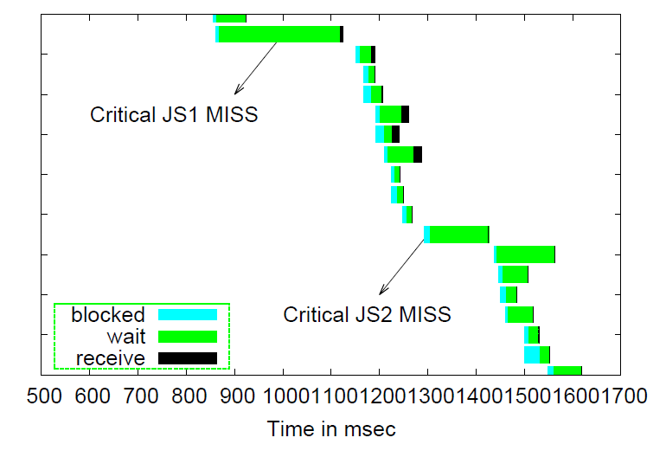

Observation 3: Delays in few objects can disproportionately impact page latency
www.weather.com
Each horizontal bar corresponds to download of an object
Two critical JS missed in CDN, increased page-load latency by 20%
Can do better if we prioritize page-critical objects to faster CDN tiers !
Objects high in dependency graph, served from farther tiers
Snapshot of waterfall diagram

Slide 12
Explore a family of priority-based placement schemes
OL Dep
depth in dependency graph
Factors impacting object prioritization
1. Inter-object dependencies
2. User perception of page latency
OL Type
Before OL > after OL
Fine: based on depth in Dependency graph
Our focus: “OnLoad” event
Placement schemes
Browser triggered: well-defined, deterministic metric for page latency
Other metrics: above-the-fold, Utility based functions
Less complex
More complex
Coarse: based on object Type
Type
HTML, CSS, JS > others
Fine grained + OL awareness: Prioritize based on depth in dependency graph
Schemes vary in sophistication and benefits
Coarse grained:
Prioritize based on obj type HTML, CSS, JS
Coarse grained + OL awareness Prioritize objects needed for page-onload event
Baseline: No prioritization
OBServed
in real-world

Slide 13

Family of proactive refresh strategies
Stale misses: object in cache, but its TTL expired
Proactively refresh objects just-in-time before they expire
Less bandwidth overhead
Pro-active refresh strategy
More bandwidth overhead
None
Html, Css, Js
Before Onload
ALL
Overhead: redundant bandwidth cost

Slide 14

Caching policy at CDNs
Traditionally: deliver popular objects quicker, minimize bandwidth cost
  popular objects → edge server
Important objects are not always popular !
naïve solution: Multiple LRU queues, one per priority level
K level - LRU Queues
Priority level 1
Priority level 2
Two problems
High priority objects stick to cache, even when not accessed
Low priority objects starved for cache space, even if popular
Priority level k
Adapt GreedyDualSize algorithm[Cao&Irani]
Proposed utility based caching policy
Utility in traditional GDS algorithm → cost/size
Our utility → priority of object for page latency

Slide 15
Evaluating priority-based caching in CDNs
Does prioritization in CDNs lower end-user page latency?
  Metric: reduction in onload time (OLT)
Evaluation Strategy: end-to-end measurements (real-world pages)
Cost of priority-based caching policy in CDNs
  Improve hit rate of critical objects with minimal impact on overall hit rates
Evaluation Strategy: Trace based simulation (real CDN traces)

Slide 16



Experimental Setup & Challenges
SPDY request/ response
Repeatability of experiments – pages change in wild
MOD_SPDY
Chrome (v43)
Web Page Replay (WPR) – record & replay
URLs change due to client code executions
e.g., random number, date
Web Page Replay
Modify WPR: return consistent URLs
TTFB
First Server (mem)
First Server (disk)
Second server
At least two servers (or origin)
Browser induced perf variability
extensions, background & sync activities
Set browser cache & user-profile directory to RAMDisk
  Emulate CDN latencies -- modify WPR
  Cache capacity: from real-world page loads
All experiments with SPDY protocol
show benefits beyond SPDY

Slide 17
Evaluation methodology
Baseline: OBServed placement with no proactive refresh
Placement Schemes | Proactive refresh schemes
OBS | None
Type | HCJ (HTML, CSS, JS)
OLType | BO (Before Onload)
OLDep | ALL
Fair comparison: maintain real-world hit-rate at all tiers
invariant: # of objects served from each tier →
vary object placement at tiers based on priority
Pin all non-cacheable objects to origin
55%
20%
5%
20%
Fixed placement
MEM
Disk
Second
Origin
75% Edge Hit Rate (EHR)
Pin stale misses to same tier as in OBS
Independently &
Meaningful combinations
except those refreshed based on PR strategy
Each assignment of objects → placement configuration
50 configurations/page/scheme

Slide 18
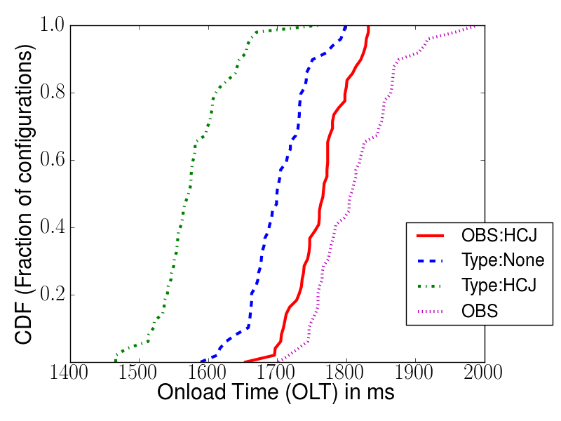
Is prioritization at CDNs beneficial ?
www.mercurynews.com
Alexa Rank: 1245
OBServed placement in real page-load
50 points: each point → OLT with a configuration
Lower is faster
Compare with following Type-based schemes:
PR ONLY – OBS placement, proactively refresh HTML, CSS, JS
> 30ms
CDF (fraction of 50 configurations)
PL ONLY – no refresh, prioritize placement of HTML, CSS, JS
> 100ms
PR ONLY
PL ONLY
PL + PR – prioritize placement of HTML, CSS, JS + proactive refresh
PL + PR
> 200ms
OBS
Priority-based placement, pro-active refresh reduces end-to-end latency

Slide 19
Benefits of Prioritization (100 Alexa pages)
Type based schemes
PR ONLY reduces >50ms for 15% of pages
PL ONLY reduces >50ms for 40% of pages
PL+ PR reduces > 50ms for 60% of pages
> 100ms for 35% of pages
> 200ms reductions for some pages
Prioritization helps reduce end-to-end latency significantly !
Reduction in 90th percentile latency -- similar trends (details in paper)

Slide 20
Can page-aware placement schemes give more benefits?
Less complex
More complex
Disable proactive refresh, vary placement schemes
OBS
Type
OL Type
OL Dep
Type-based placement sufficient for most pages
22% of pages show more benefits with OLDep
Benefits >50ms for 4% pages

Slide 21


When does prioritization beyond Type help?
Object Type
Required for onload
Prioritized by Type
Prioritized by OLType & OLDep
Other
HCJ
HCJ
Other

Slide 22
Can page-aware proactive refresh strategies give more benefits ?
OBS placement, but vary refresh strategy
Fewer objects refreshed
Refresh Strategies
More objects refreshed
Html,Css,Js
BeforeOnload
None
ALL
Our results:
HCJ refresh strategy - sufficient for majority of pages
Before Onload strategy significantly better than HCJ for 5% pages

Slide 23
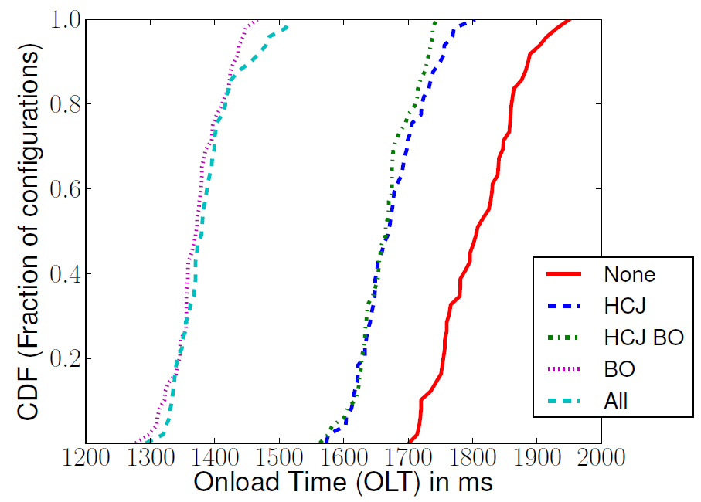
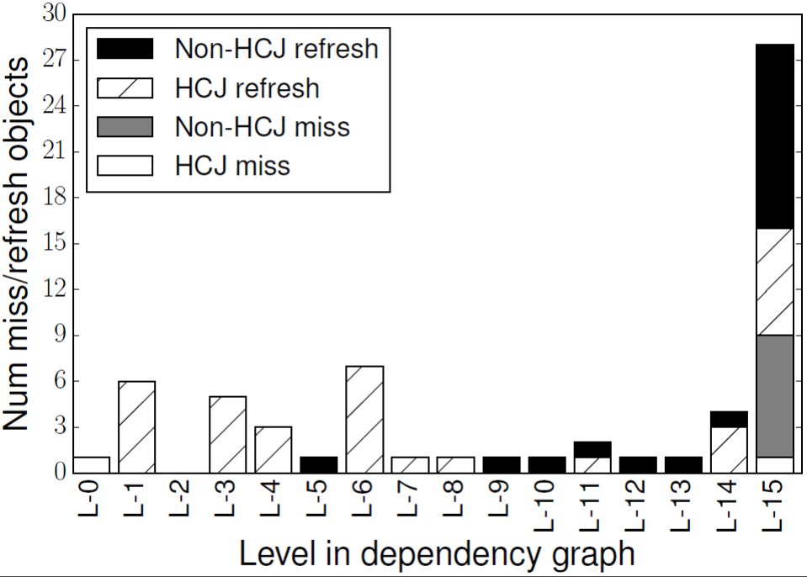
When does proactive refreshing beyond HCJ help?
Case Study: www.mercurynews.com
More interestingly,
BO better!
BO ≈ ALL
HCJ ∩ BO ≈ HCJ
refreshing HCJ required Before Onload ≈ refreshing all HCJ
refreshing all Before Onload ≈ refreshing ALL objects
Stale misses for Non HCJ objects – avoided by Before Onload strategy
Possibility to get high benefits, by refreshing a smaller subset of objects !

Slide 24
Cost of priority-based caching in CDN
Trace based simulation: Our algorithm vs LRU-Thresh
Traces from real CDN deployment
13 million objects; 160 million requests
  Week long, non sampled trace from 18 servers
  Same cache capacity observed in real deployment
Type based prioritization in caching policy
Decrease miss rate of HCJ objects by 61%
< 0.5% increase in overall miss rate
Type based proactive refresh
Decrease stale misses of HCJ objects by 60%
< 0.02% increase in overall bandwidth

Slide 25

Related work in lowering web-latency
Measure the impact of dependencies on page-load latency
  W-Prof, Web Prophet, KLOTSKI
  Our focus: prioritization in CDNs, can work hand-in-hand with these systems
Web caching algorithms - [Cao’97, Jin’00, Korupolu’02, Tewari’99, Wang’99]
  Balances locality of accesses, capacity, object sizes and cost on misses
Our focus: evaluating latency benefits of prioritization in CDN, with minimal impact on cost
Hierarchical caching systems [Chankhunthod ’95 ’96 Che’02]
  Minimize average latency; given constraints on capacity and bandwidth
Our focus: caching based on importance of object to page latency

Slide 26



Conclusions
Opportunity to improve whole-page experience
mapping critical content to faster cache tiers
Benefits of content prioritization in CDNs
  >100 ms reduction in median latency for 35% of Alexa Top pages
Type based prioritization sufficient for many pages
  Further benefits of page-awareness depends on factors like
  hit rates, page composition and origin latencies
Cost of priority-based caching
  Decrease miss rate of critical objects by 61%, < 0.5% increase in overall miss rate

Slide 27



